Slide 1

Recurrent Neural Networks
Presented by:
Elizer Ponio Jr.
Department of Computer Science
College of Computing and Information Technologies

Slide 2
Outline
Introduction
Text Sequences
Recurrent Neural Network
Memory Elements
Temporal Dependencies

Slide 3
Introduction
In the previous lesson, we focused on Tokenization and Embeddings, which helped convert text into useful data for input into neural networks.
However, these networks were not yet able to consider the actual sequence of the words in the input.

Slide 4
Text Sequences
I saw a beautiful ________
If someone said to you “I saw a beautiful…”, you might guess what comes next but there are a lot of possibilities.
“I saw a beautiful flower”
“I saw a beautiful house”
“I saw a beautiful shirt”

Slide 5

Text Sequences
When I was down at the docks,
I saw a beautiful ________

Slide 6
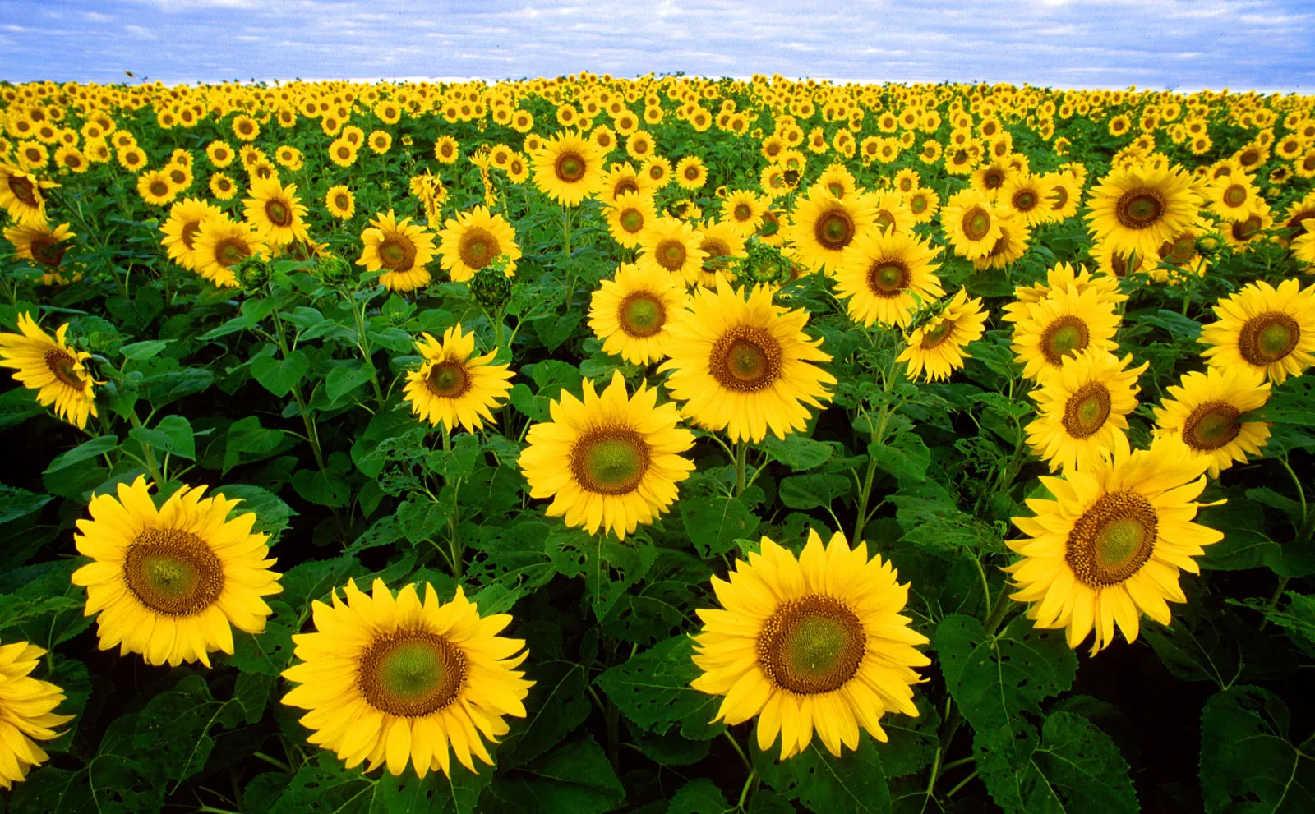
Text Sequences
When I was in the garden,
I saw a beautiful ________

Slide 7

Text Sequences
When I was at the bakery,
I saw a beautiful ________

Slide 8

Words that affect each other can be close together
He put up his ___ in the rain
He put up his umbrella in the ___
The boat sailed out of the ___
The ___ sailed out of the harbor
In this example, it is easy to guess what the blanks are because they are near to the words that affect them

Slide 9

Words that affect each other can be further apart
“My mom gave me a
bicycle
on my birthday because she
knew that I wanted to
go biking
with my friends.”
In this example, the thing that I want on my birthday depends on what I want to do with my friends

Slide 10

Words that affect each other can be further apart
“My mom gave me a
tent
on my birthday because she
knew that I wanted to
go camping
with my friends.”

Slide 11
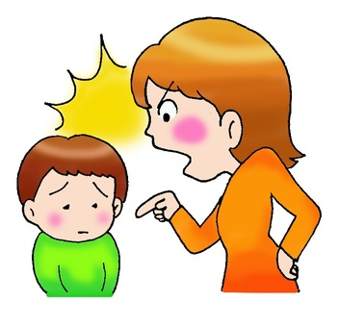
Words that affect each other can be further apart
“My mom gave me a
scolding
on my birthday because she
knew that I wanted to
skip school
with my friends.”

Slide 12
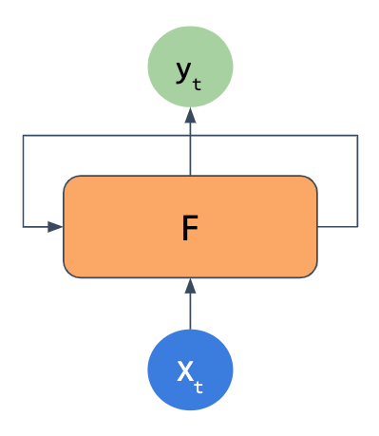
RNN
Recurrent Neural Network (RNN)
Recurrent Neural Networks (RNNs) take in some input x and output some y, but they also feed some of the output of the network back into itself.
This may be done over and over, so that with text input, the network has some memory of words that came much earlier in a sequence.

Slide 13
Recurrent Neural Network (RNN)
Definition of Recurrent
Simply means “Occurring often or repeatedly”

Slide 14
Why is it called Recurrent Neural Network?
What
time
is
it
?

Slide 15
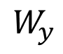
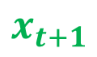

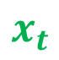
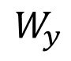

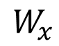

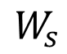
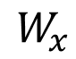
Memory Elements
RNNs have internal memory elements called states that capture information of previous inputs.
$$W_{y}$$
$$W_{y}$$
$$\overline{S}$$
$$\overline{S}$$
$$W_{s}$$
$$W_{s}$$
$$W_{x}$$
$$W_{x}$$
$$x_{t}$$
$$x_{t+1}$$

Slide 16


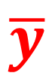
Temporal Dependencies
$$\overline{y}$$
Dependencies Over Time
Many applications have temporal dependenciesMeaning that the current output depends not only on the current input, but also on a memory element which takes into account past inputs
$$W_{y}$$
$$\overline{s}$$
$$W_{s}$$
$$W_{x}$$
$$\overline{x}$$
Notes:
It is simply because it performs that same task for each element in the input sequence

Slide 17
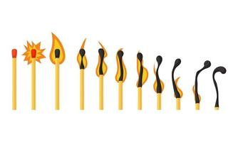
Temporal Dependencies
Temporal dependencies refer to the idea that certain events or actions rely on each other happening in a specific order or within a particular timeframe.
There is a sequence or timing that needs to be followed for things to work properly.
Some things need to happen before or after others, and the timing matters.

Slide 18
Temporal Dependencies Examples
In software development, writing code often requires completing tasks in a specific sequence. For example, you cannot test a feature before you've written the code for it.
In manufacturing a car, certain parts need to be assembled before others. For example, you cannot put the engine on a car before you've built the body.
When cooking adobo, you need to follow the recipe in order. For example, you cannot put the engine on a car before you've built the body.

Slide 19


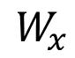
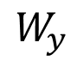
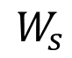

Temporal Dependencies
$$y$$
$$W_{y}$$
$$s$$
$$W_{s}$$
$$W_{x}$$
$$x$$

Slide 20


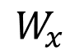
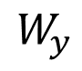
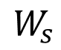

Temporal Dependencies
$$y$$
Many applications have temporal dependencies
Meaning that the current output depends not only on the current input, but also on a memory element which takes into account past inputs
$$W_{y}$$
$$s$$
$$W_{s}$$
For cases like these, we need to use RNNs
$$W_{x}$$
$$x$$

Slide 21
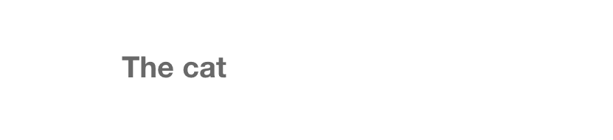
Recurrent Neural Networks
A good example for the use of RNN is predicting the next word in a sentence
Predicting the next word typically requires looking at the last few words rather that only the current word

Slide 22
Recurrent Neural Networks
Other applications that use RNNs include:
Sentiment Analysis
Speech Recognition
Time Series Prediction
Gesture Recognition

Slide 23
RNNs versus Feed Forward NNs
RNNs are based on the same principles behind feed forward neural networks
Just as feed forward neural networks, in the RNN network the inputs and outputs can also be many-to-many, many-to-one and one-to-many
There are however, two fundamental differences between RNNs and Feed Forward NNs

Slide 24
RNNs versus Feed Forward NNs
There are however, two fundamental differences between RNNs and Feed Forward NNs
 | RNN | Feed Forward NN
Input and Output Process | Uses input and the previous output to generate new output at each time step | Uses single input and generates single output at each time step
Memory Element | Uses states to store output from previous time step | Does not use memory

Slide 25
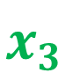

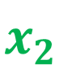
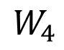
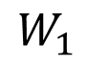
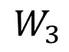
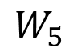
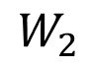
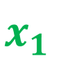
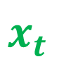
RNNs versus Feed Forward NNs
$$x_{1}$$
$$W_{1}$$
$$x_{2}$$
$$W_{2}$$
$$\hat{y}$$
$$W_{3}$$
$$W_{5}$$
$$x_{3}$$
$$W_{4}$$
$$x_{t}$$
Notes:
Instead of training the network using a single-input, single output at each time step, we train with sequences since previous inputs matter

Slide 26
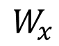
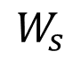
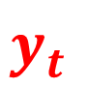
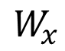
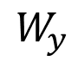
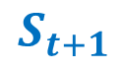

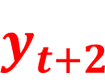
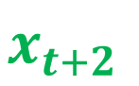
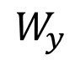
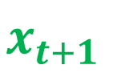
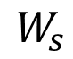
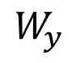
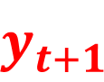

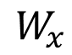
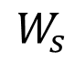
RNNs versus Feed Forward NNs
$$y_{t}$$
$$y_{t+1}$$
$$y_{t+2}$$
$$W_{y}$$
$$W_{y}$$
$$W_{y}$$
$$S_{t}$$
$$S_{t+1}$$
$$W_{s}$$
$$W_{s}$$
$$W_{s}$$
$$W_{x}$$
$$W_{x}$$
$$W_{x}$$
$$x_{t}$$
$$x_{t+1}$$
$$x_{t+2}$$
Notes:
Instead of training the network using a single-input, single output at each time step, we train with sequences since previous inputs matter

Slide 27
RNNs versus Feed Forward NNs
$$y_{t}$$
$$y_{t+1}$$
$$y_{t+2}$$
$$W_{y}$$
$$W_{y}$$
$$W_{y}$$
$$S_{t}$$
$$S_{t+1}$$
$$W_{s}$$
$$W_{s}$$
$$W_{s}$$
$$W_{x}$$
$$W_{x}$$
$$W_{x}$$
$$x_{t}$$
$$x_{t+1}$$
$$x_{t+2}$$
Notes:
The second difference, stems from the memory elements that RNNs host

Slide 28


RNN Folded Model
$$y$$
$$W_{y}$$
$$s$$
$$W_{s}$$
$$W_{x}$$
$$x$$

Slide 29
RNN Unfolded Model
$$y_{t}$$
$$y_{t+1}$$
$$y_{t+2}$$
$$W_{y}$$
$$W_{y}$$
$$W_{y}$$
$$S_{t}$$
$$S_{t+1}$$
$$W_{s}$$
$$W_{s}$$
$$W_{s}$$
$$W_{x}$$
$$W_{x}$$
$$W_{x}$$
$$x_{t}$$
$$x_{t+1}$$
$$x_{t+2}$$
Notes:
Instead of training the network using a single-input, single output at each time step, we train with sequences since previous inputs matter

Slide 30
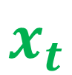

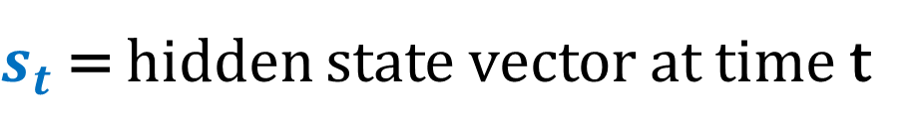
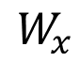
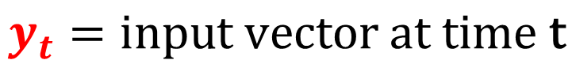
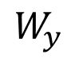
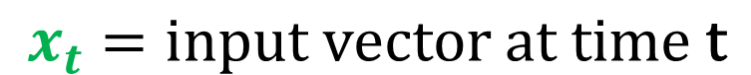

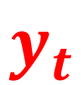
Recurrent Neural Network
$$y_{t}$$
$$W_{y}$$
$$x_{t}=\text{input} \text{vector} \text{at} \text{time} \text{t}$$
$$s_{t}$$
$$W_{s}$$
$$y_{t}=\text{input} \text{vector} \text{at} \text{time} \text{t}$$
$s_{t}$ = hidden state vector at time t
$$W_{x}$$
$$x_{t}$$

Slide 31





Recurrent Neural Network
$$y_{t}$$
$$W_{y}$$
$$s_{t}= Φ(x_{t}⋅W_{x}+ s_{t−1}⋅W_{s})$$
$$y_{t}= s_{t}⋅W_{y}$$
$$s_{t}$$
$$W_{s}$$
$$y_{t}= σ(s_{t}⋅W_{y})$$
$$W_{x}$$
$$x_{t}$$

Slide 32

Stacking RNNs
RNNs can also be stacked or can have multiple layers just as feed forward neural networks can

Slide 33

































$$z_{t}$$
$$z_{t+1}$$
$$z_{t+2}$$
$$W_{y}$$
$$W_{y}$$
$$W_{y}$$
$$S_{t}$$
$$S_{t+1}$$
$$z=rnn2.step(y)$$
$$W_{s}$$
$$W_{s}$$
$$W_{s}$$
$$W_{x}$$
$$W_{x}$$
$$W_{x}$$
$$y_{t}$$
$$y_{t+1}$$
$$y_{t+2}$$
$$W_{y}$$
$$W_{y}$$
$$W_{y}$$
$$S_{t}$$
$$S_{t+1}$$
$$y=rnn1.step(x)$$
$$W_{s}$$
$$W_{s}$$
$$W_{s}$$
$$W_{x}$$
$$W_{x}$$
$$W_{x}$$
$$x_{t}$$
$$x_{t+1}$$
$$x_{t+2}$$
Notes:
Instead of training the network using a single-input, single output at each time step, we train with sequences since previous inputs matter

Slide 34
Long Short Term Memory (LSTM)
RNNs can also be stacked or can have multiple layers just as feed forward neural networks can

